Slide 1

Testing Personal Cell Phone Usage vs. National Average
Michael Slathar
Data 211- Spring 2025

Slide 2
Question: How does my personal average daily cell phone usage compare to the national Average?
The national average daily cell phone usage is roughly 4 hours, 30 minutes.
Americans check their phones on average 144 times per day.
Source: https://www.consumeraffairs.com/cell_phones/cell-phone-statistics.html

Slide 3
Justification for Data and Question Selection
Personal curiosity of daily average screen time drove me to test my daily average vs the national average.
Societal relevance given widespread use of electronic devices and the growing focus on said devices' impact on mental health and well-being.
Understanding personal reliance on mobile device(s).
Allows me to practice fundamental Data Science techniques.

Slide 4
Data - Key Characteristics
Sample Size: One participant (myself), with daily entries that will amount to 14 observations.
Time Period: 14 days.
Data Type: Quantitative, screen time in hours. (minutes displayed as 0.00-0.99)
Variables in data collection:
Dependent: Screen Time (measured in hours per day)
Independent: Date (24 hour interval)

Slide 5
Data table (data frame)
Day | Screen Time
4/6 | 3.05
4/7 | 1.97
4/8 | 1.55
4/9 | 2.17
4/10 | 1.10
4/11 | 1.02
4/12 | 4.13
4/13 | 2.35
4/14 | 4.07
4/15 | 2.83
4/16 | 1.07
4/17 | 3.80
4/18 | 2.08
4/19 | 1.10
Recorded daily screen time from April 6th, 2025, until April 19th, 2025, using my phone’s a built-in screen-time tracker.
Calculated personal average as roughly 2.31 hours per day using mean method in R.
mean(data$Screen_Time)
[1] 2.30642
Fun fact: I gave up video games (until next winter) on April 12th, so there was a void to fill from that day on.

Slide 6
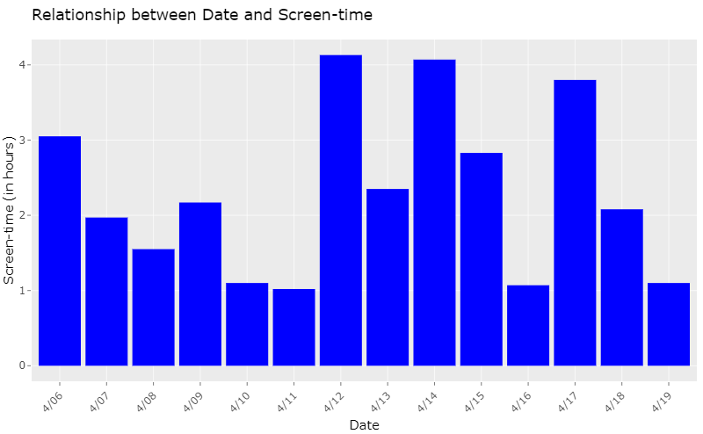
Bar Graph of Data

Slide 7
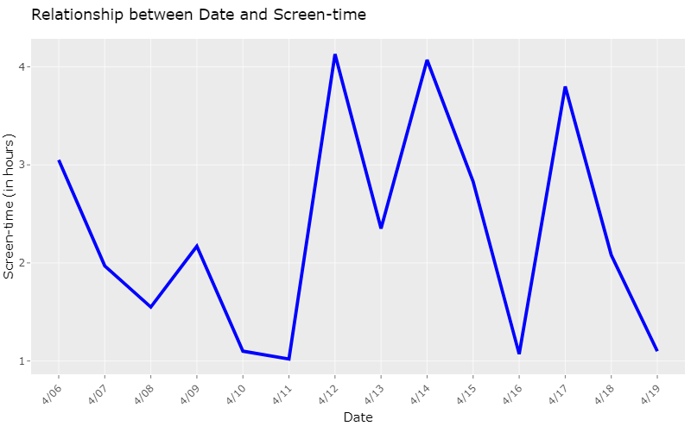
Time-series Plot of Data

Slide 8
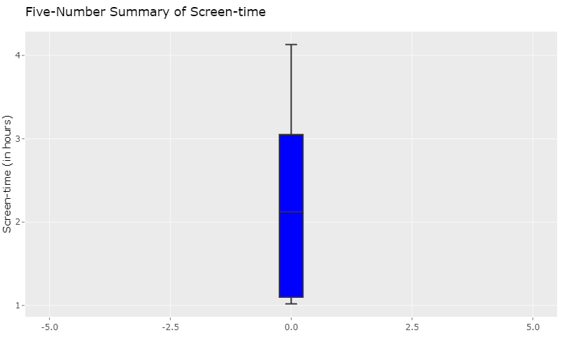
Boxplot of Data

Slide 9
Hypothesis
Hypothesis: My true average daily cell phone screen-time is equal to 4.5 hours a day.
Alternative Hypothesis: My true average daily cell phone screen-time is less than 4.5 hours a day.
Testing: This hypothesis will be tested using a T-test, at a 0.05 significance level.

Slide 10
Hypothesis Testing
Step 1:
Null Hypothesis:
H_{o} : µ = 4.5
Alternative Hypothesis:
H_{a} : µ < 4.5
Step 2:
Use T-test

Slide 11
Hypothesis Testing
Step 3:
Test Statistic
T = -7.3197
P-value = 2.917e-06
Step 4:
Using a significance level of 0.05, reject the null hypothesis
One Sample t-test
data: data$Screen_Time
t =-7.3197, df = 13, p-value = 2.917e-06
alternative hypothesis: true mean is less than 4.5
95 percent confidence interval:
-Inf 2.837143
sample estimates:
mean of x
2.306429

Slide 12
Conclusion
With a P-value of 2.917e-06 and a significance level of 0.05, since the p-value is significantly less than 0.05, there is sufficient evidence to reject the null hypothesis (H_{o} : µ = 4.5). At the 5% significance level, we can conclude that my true average daily cell phone screen-time is significantly less than the national average daily cellphone screen-time (H_{a} : µ < 4.5).
Github Repository:
https://github.com/mslathar/data211

